Slide 1
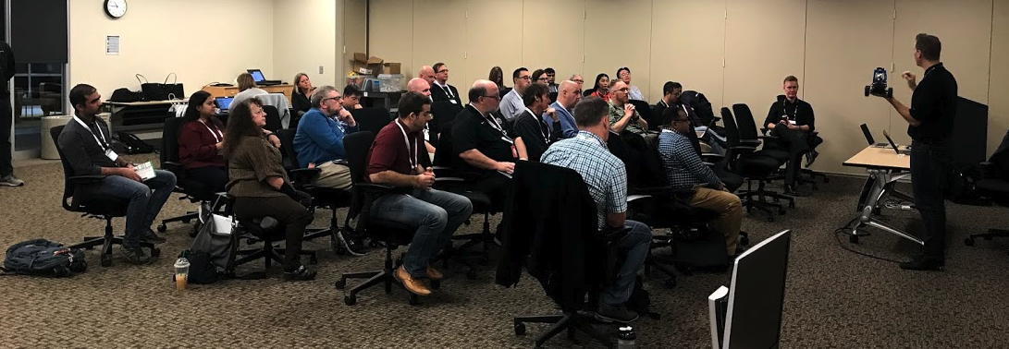
AI Racing League November 2019 Update
Mentor Training Class #4

Slide 2
AI Racing League
Vision, Alignment and Reach
The AI Racing League is a platform for AI education initiated out of the Optum Tech Social Responsibility program, envisioned for use by many businesses, with multiple stakeholders, mentors, participants and sponsors, reaching internal and external constituents.
“Let’s judge ourselves not on how we look in meetings. Let’s judge ourselves by the substance of impact we have on people’s lives.”
Andrew Witty, a CEO Conversation
“Let’s construct a campaign for employees to learn AI in a fun way.”
John Santelli, June 2019

Slide 3
Three Key Objectives
Create a fun hands-on event that will draw in skilled AI mentors
Hands-on events require high-touch (student/mentor = 3/1)
Leverage open-source DonkeyCar software and low-cost hardware Limited budgets for mentor charge-backs to account
Make the event accessible to everyone
Included non-technical staff
Take the fear out of AI
Create a testbed for AI-based learning management system
Graph of key concepts
Enable learning content recommendation engine

Slide 4
November Event
Sprint 4
34 attendees
New “portable” GPU server configured by Jon Herke
High NPS despite technical problems in final drive function

Slide 5
ATC Leaders
Paith Philemon
Sean Leary
Jon Herke
Nicole Swanson
Carl Boudreau
Dan McCreary

Slide 6
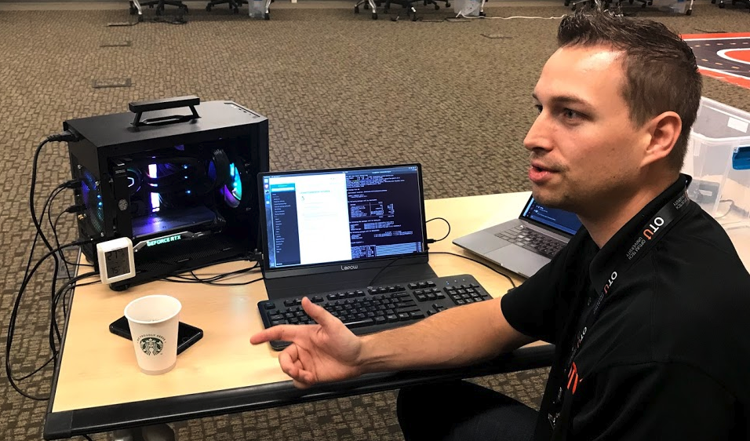
Jon Herke’s New “Portable” GPU Server
GPUS server weight lowered from around 70 pounds down to around 25 pounds – with a handle and LEDs

Slide 7
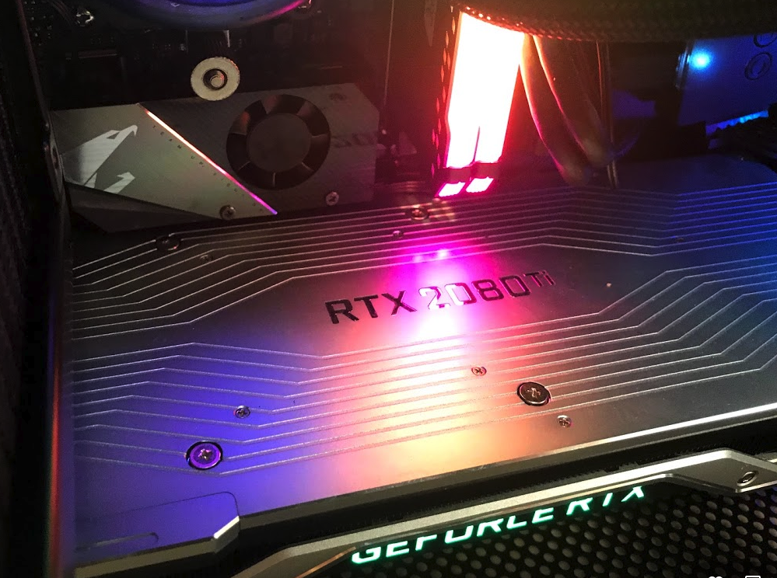
New NVIDIA GeForce RTX 2080 TI
Training time for 10K events now under 1 minute!

Slide 8
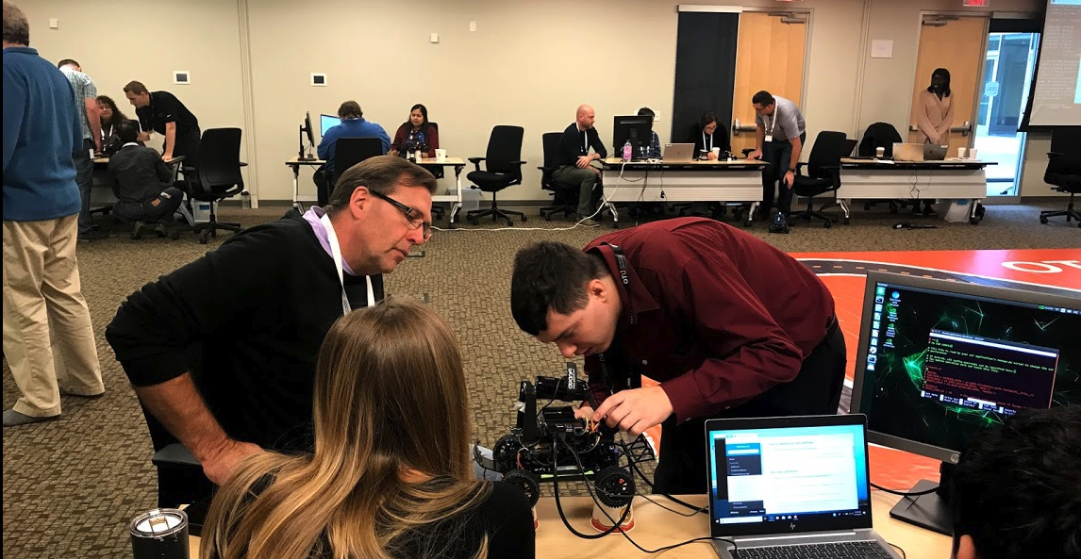
Sean Leary Helping Out

Slide 9
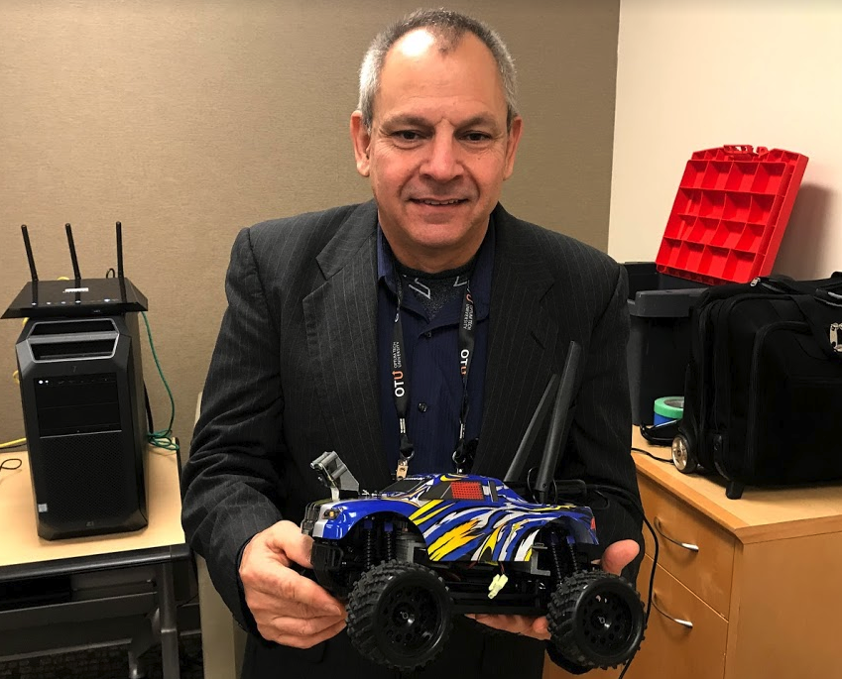
Mentors Purchasing and Building Custom Cars
Carl Boudreau – extensive 3D printing for customization of mounting

Slide 10
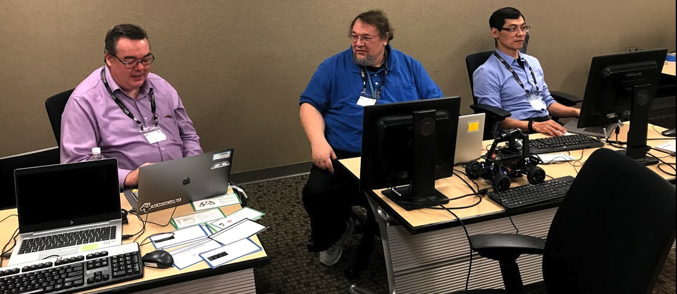
Better Concept Cards
Continue to get feedback on what concepts are important

Slide 11
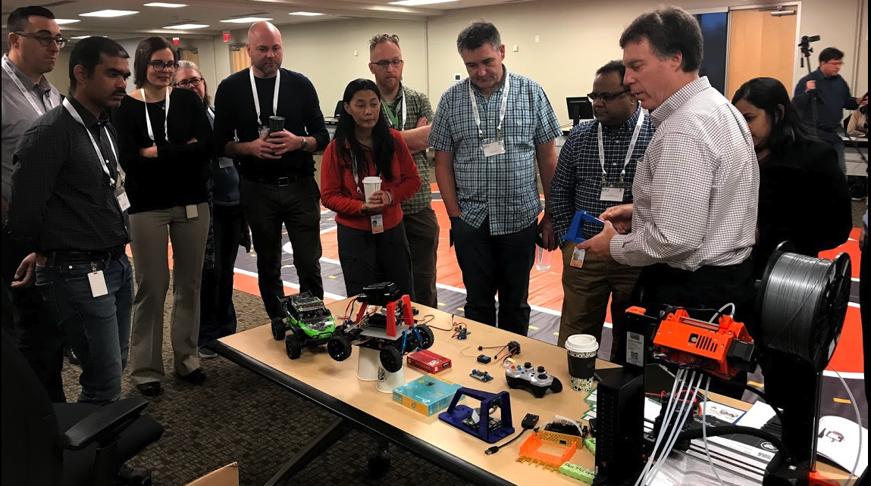
Customized hardware with 3D printer
New 3D
Printer
Randy explaining our hardware

Slide 12
Next Sprint
Less time on calibration, more time on AI models
Launch internal marketing campaign to find more mentors
Finding problems in the drive functions
New concept cards
Better Jupyter notebooks for data analysis
Integrate new OTU 3D printer
Better camera mounting
Github site updates with GPU parts list

Slide 13
Future Locations
Dublin Ireland (hardware purchased)
Boston - looking for new contact person
Letterkenny Ireland – contact Jamie O’Leary
India – looking for new contacts

Slide 14
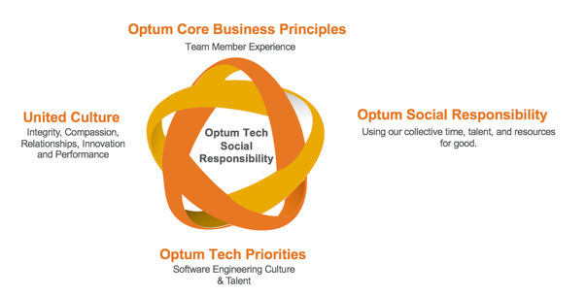
Optum Technology Social Responsibility
Mission Statement
Enable and nurture social responsibility engagements that leverage Optum Tech team members’ knowledge, relationships and passion to serve communities they live in, elevate STEM knowledge and ultimately live our culture.
Get employees out into communities
Deliver a broad and long-term impact globally
Align our social responsibility
@OptumTech_SR
Notes:
WHO
STEM being the main initiative of Optum Tech SR,
How people can get involved
If you’re working on STEM
- Tell us stories
- Send pictures
- The number of people (lives) you’re impacting
- Understanding the breadth and depth for our impact so encourage you to track your service hours no matter what you do
We also know there are many ways people are making an impact with their tech skills, so want to call out some pro bono efforts of the team and highlight a few people there.
Optum Technology is in a unique position with its talent pool to help drive Optum Impact through STEM focused work.
Get employees out into communities we operate to support UHG’s mission to help people live healthier lives and help the health system work better for everyone.
Deliver a broad and long term impact globally while optimizing the use of Optum Technology’s capabilities to drive successful social responsibility.
Align our social responsibility with the focus of Optum Social Responsibility as well as Optum priorities and United Culture Values
https://unsplash.com/photos/vCblQxO7oPY
Photo by Diego Morales on Unsplash

